Slide 1


c17 portfolio Project: Family Day Out Planner By Yuan fang jacQueline lu matthew brinkmann

Slide 2

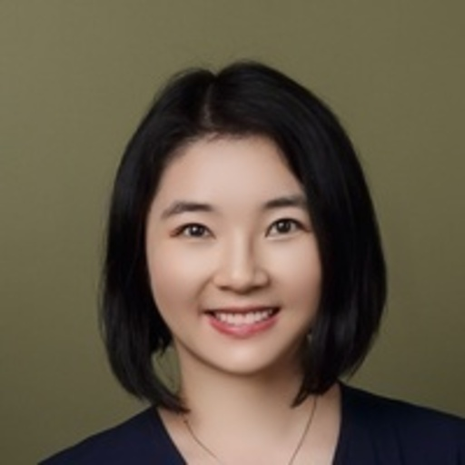

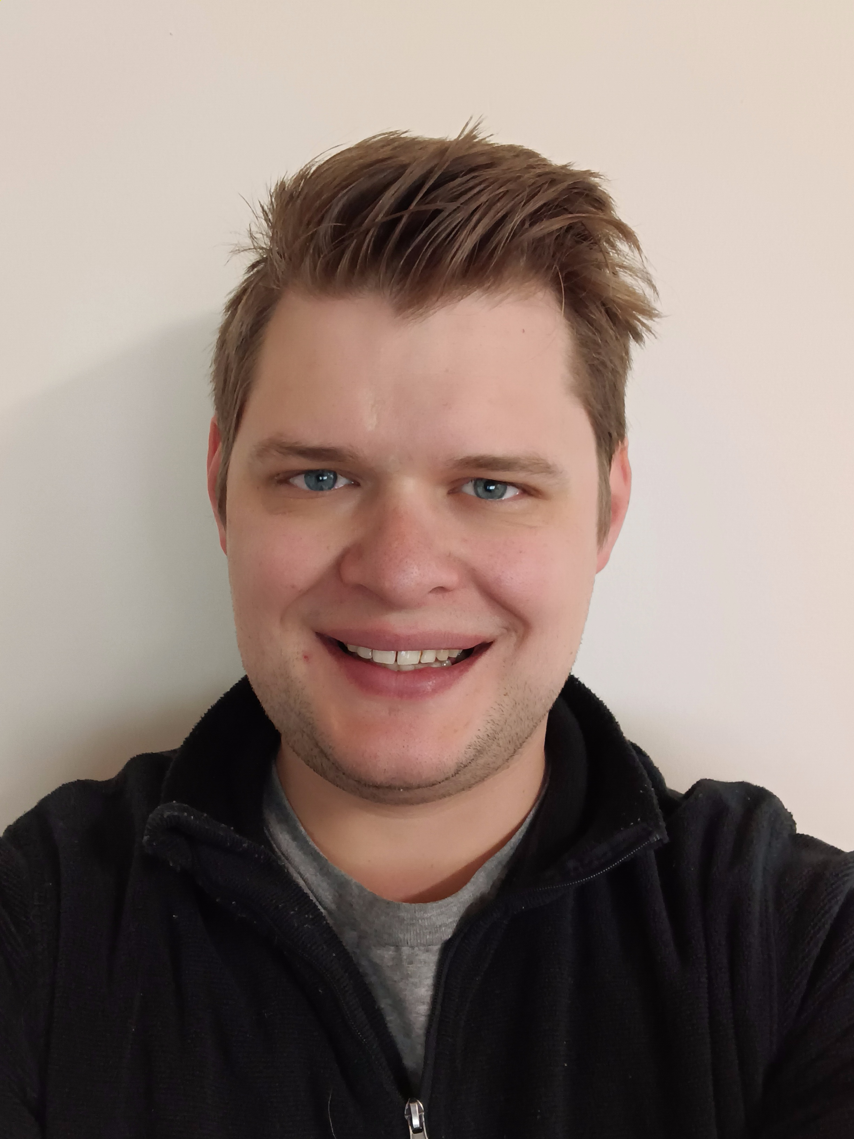
Who WE ARE?
Yuan Fang
SerpAPI
WeatherAPI
Back End Developer
DB integration
Jacqueline Lu
HTML Development
React Development
Google API
Matthew Brinkmann
Project Architecture
Slack Integration
Swagger Integration
Flask Implementation

Slide 3

What are we trying to achieve
We are aiming to assist families in planning short trips or days out. We will provide a list of activities in an area and pair that with the weather at the location.
This will also help plan detours in larger holidays by finding activities near the location the family is staying at.

Slide 4


DEMO
SWAGGER

Slide 5


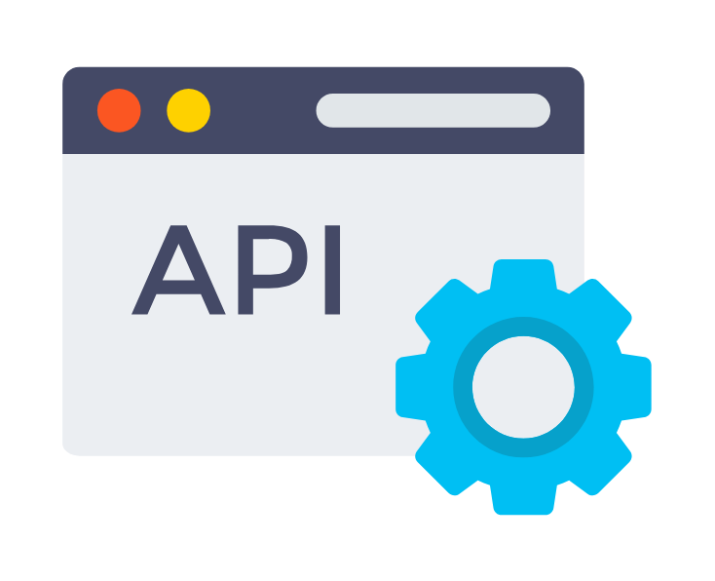
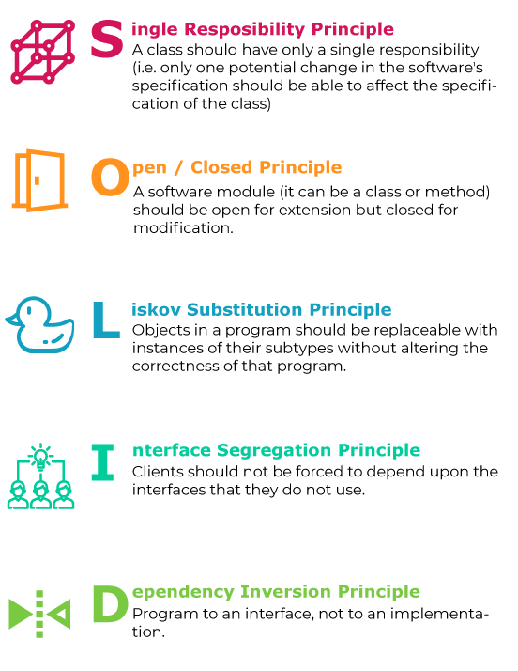


Our Goals:
We are looking to reinforce our learning with this project, it’s not so much about what we create, but how we create it and how well put together it is.
Solid Code (S.O.L.I.D. principles)
Unit Testing – Code coverage
Interact with external API
Create our own API
Full Documentation

Slide 6
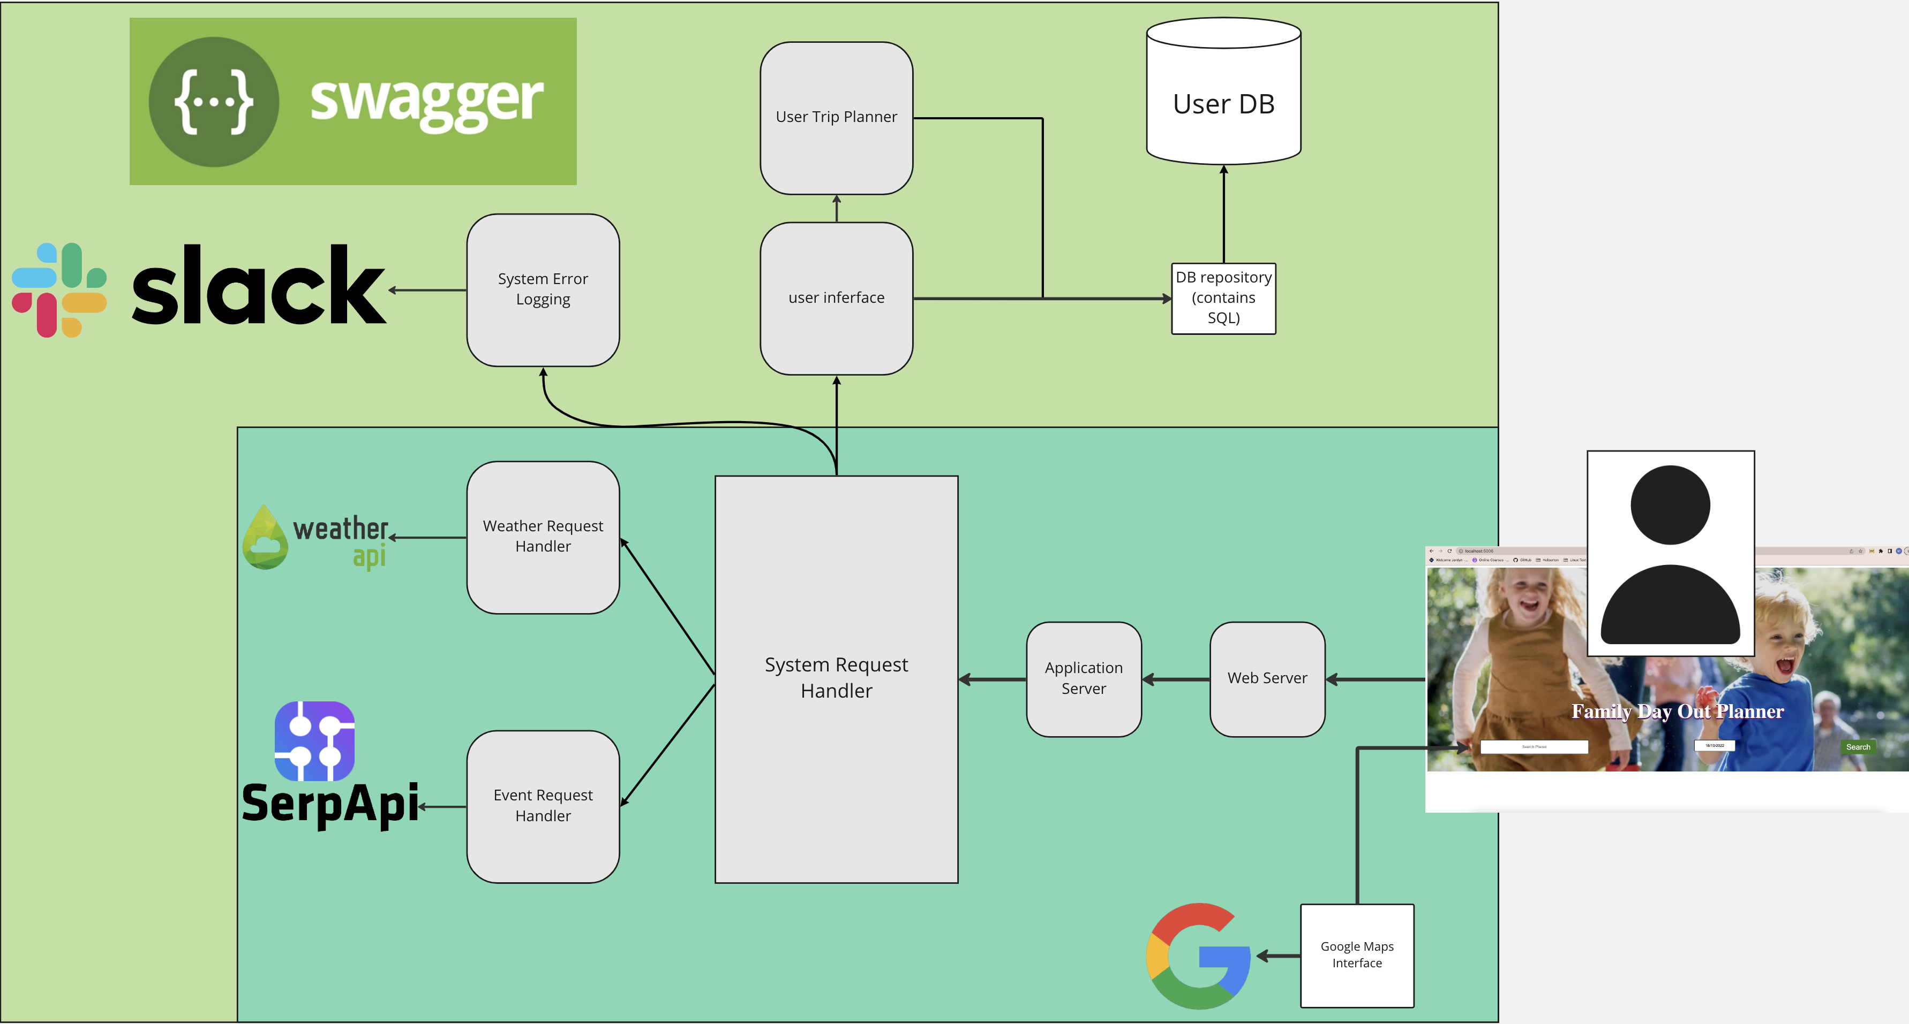






MVP

Slide 7
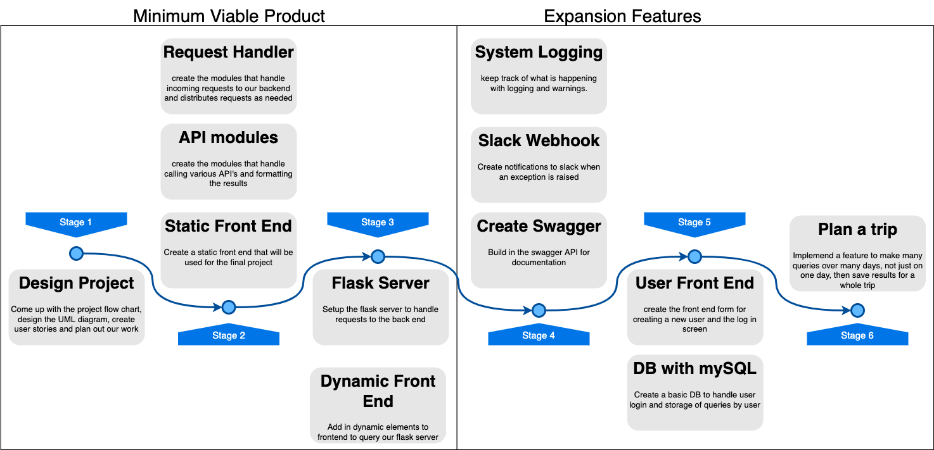


Slide 8

Challenges
CHALLENGES | SOLUTIONS
Running out of API calls during development.
Writing unit tests that covered our API calls and Custom exceptions.
Developing frontend and backend synchronously.
Staying on track with tasks
Capture a real API call and save it, then use it with a test endpoint.
Solution was actually to recode parts of our project to make testing easier.
Communication and Clear task definition.
Using Trello board with cards and daily catch-ups
We faced several challenges during development. Here are some of the key challenges faced and how we over come them.

